Slide 1

50.039 Theory and Practice of Deep Learning W8-S2 The Embedding Problem
Matthieu De Mari

Slide 2
About this week (Week 8)
Why are embeddings an essential component of Neural Networks (NNs)?
Why are good embeddings difficult to produce?
What are the conventional approaches to embeddings in NLP? What can we learn from these approaches?
What are the typical issues with embeddings and how do we address them?
State-of-the-art of current embedding problems, and open questions in research.

Slide 3
About this week (Week 8)
How do we evaluate the quality/performance of an embedding?
Can embeddings be biased?
Can we help the neural networks identify the important parts of the context to focus on?
What is attention in Neural Networks? What are transformers in Neural Networks?
What are the typical uses for attention these days?
What are the limits of attention and the current research directions on this topic?

Slide 4
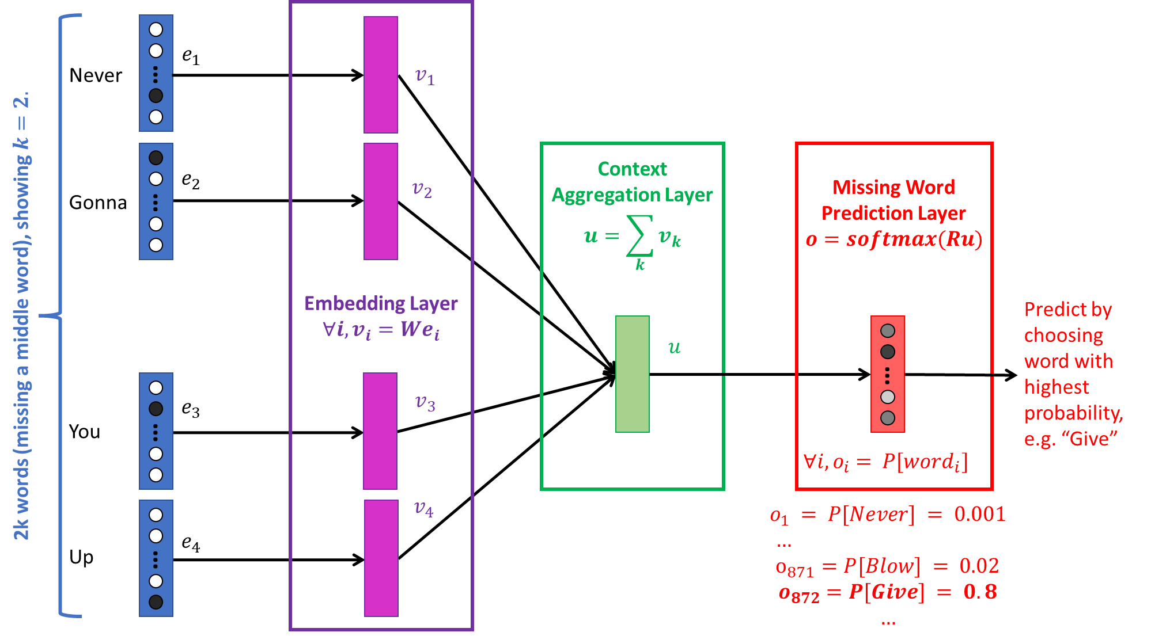
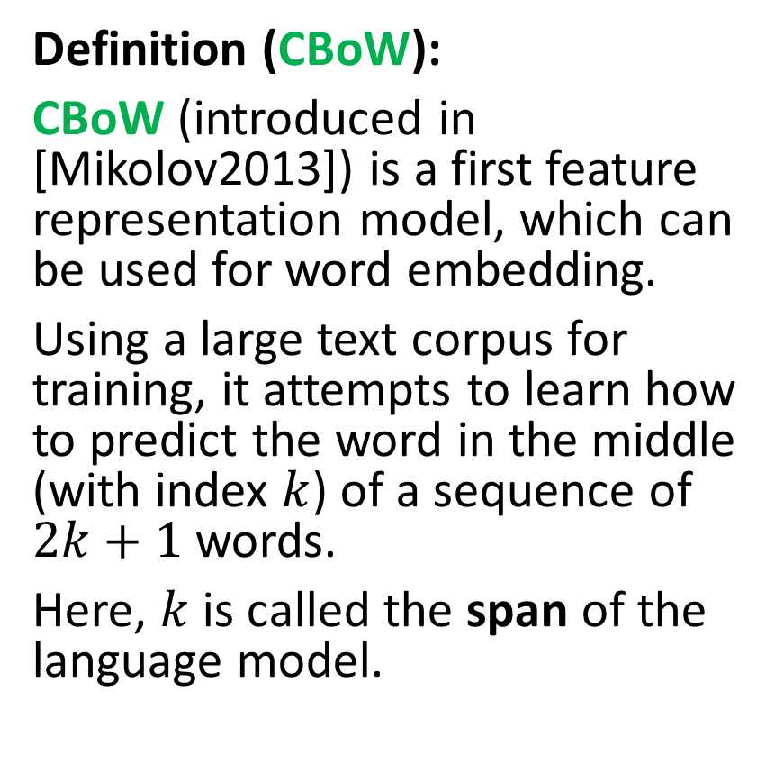
Continuous Bag of Words (CBoW)
Definition (CBoW):
CBoW (introduced in [Mikolov2013]) is a first feature representation model, which can be used for word embedding.
Using a large text corpus for training, it attempts to learn how to predict the word in the middle (with index $k$) of a sequence of $2k+1$words.
Here, $k$ is called the span of the language model.

Slide 5
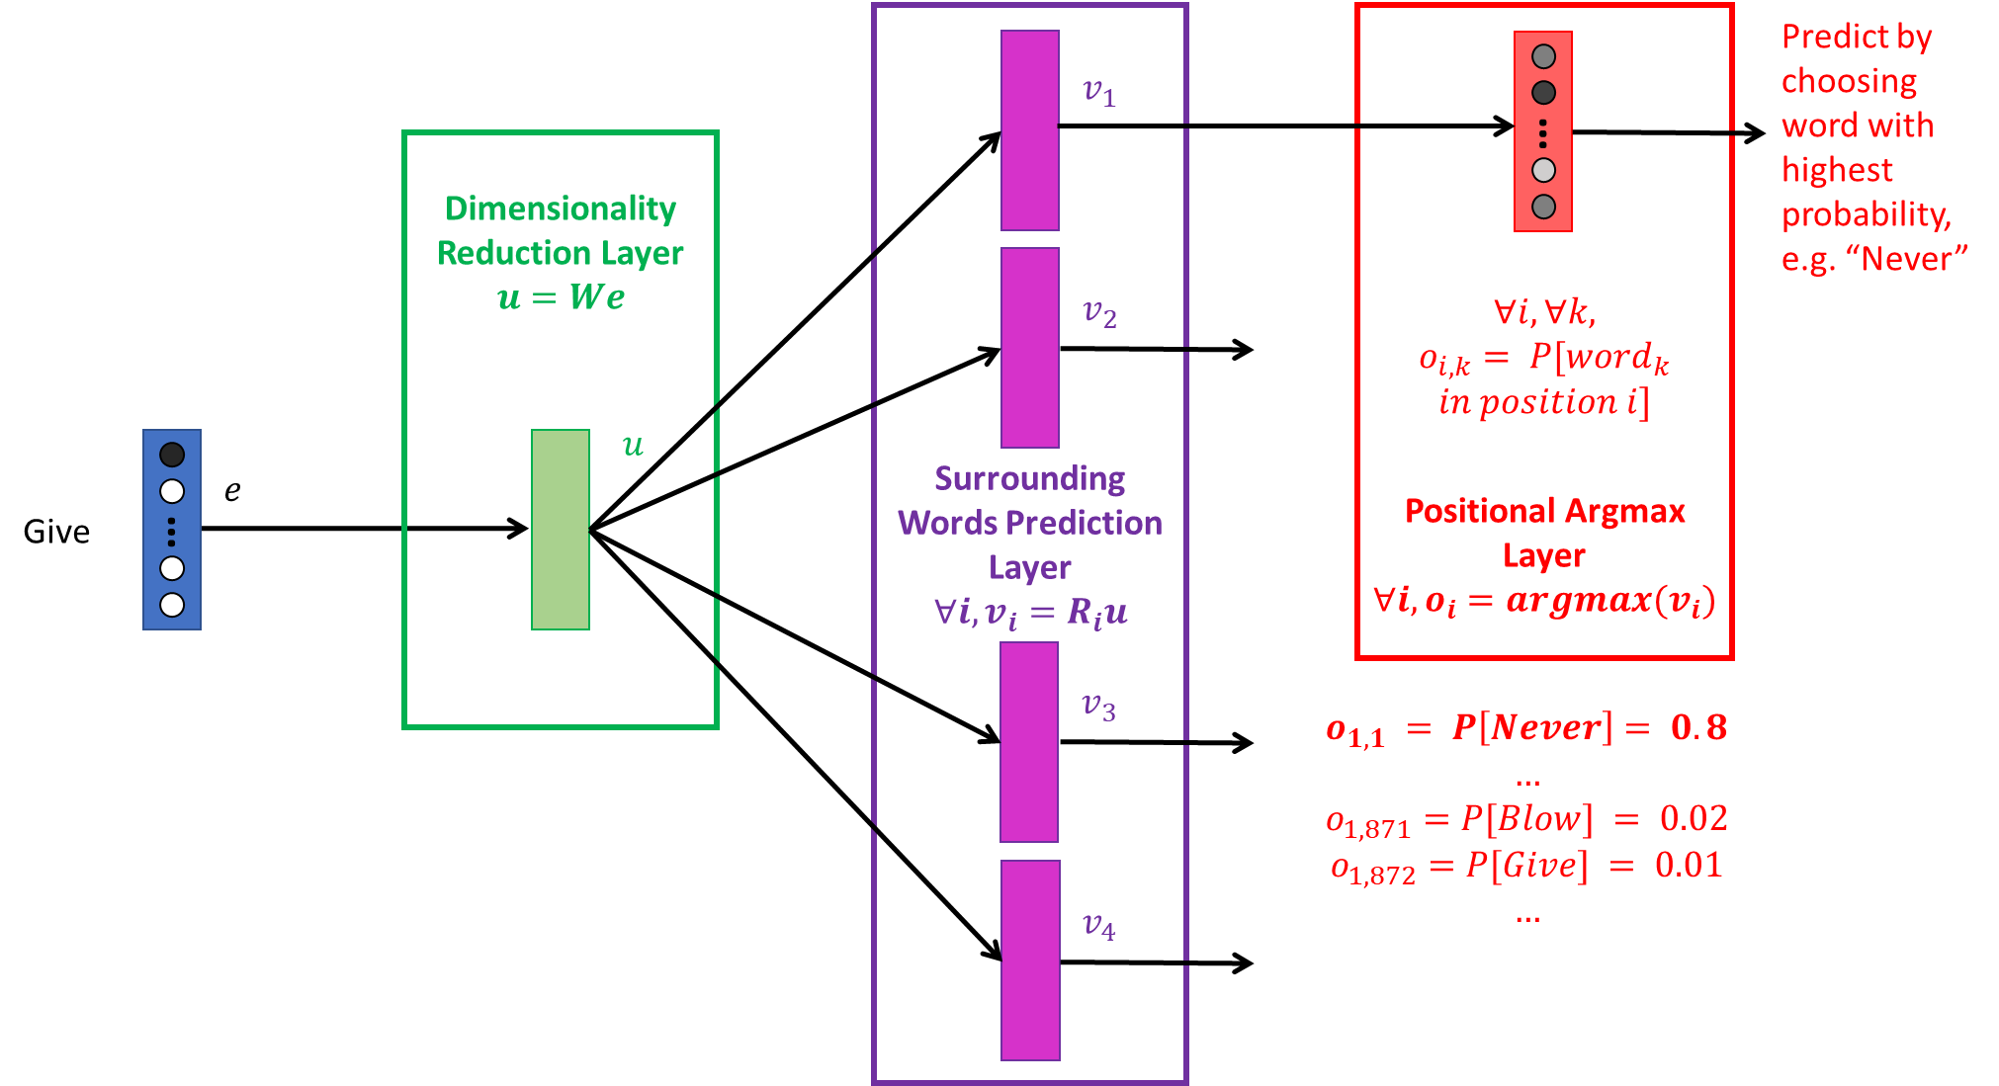
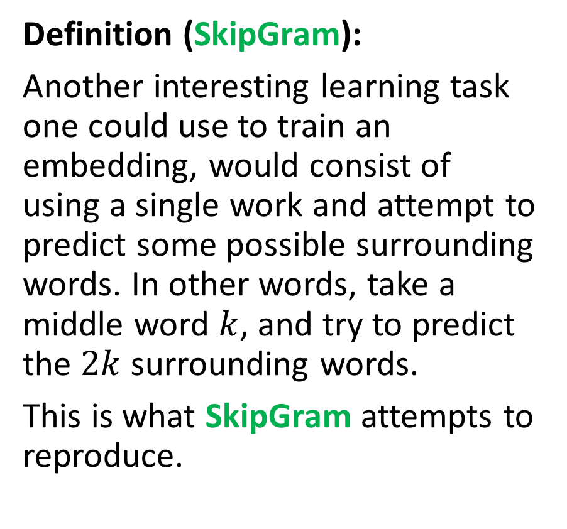
SkipGram (SG)
Definition (SkipGram):
Another interesting learning task one could use to train an embedding, would consist of using a single work and attempt to predict some possible surrounding words. In other words, take a middle word $k$, and try to predict the $2k$ surrounding words.
This is what SkipGram attempts to reproduce.

Slide 6


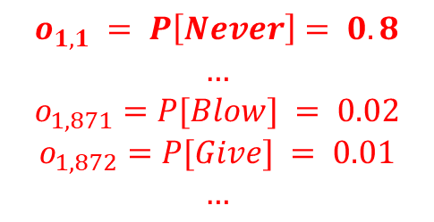


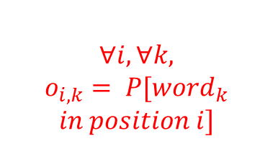





Surrounding Words Prediction Layer
$$∀i, v_{i}=R_{i}u$$
Positional Argmax Layer
$$∀i, o_{i}=argmax(v_{i})$$
Predict by choosing word with highest probability, e.g. “Never”
$$v_{1}$$
…
Dimensionality Reduction Layer
$$u=We$$
$$∀i, ∀k,$$
$$o_{i,k}= P[word_{k}$$
$$in position i]$$
$$v_{2}$$
$$u$$
$$e$$
Give
…
$$v_{3}$$
$$o_{1, 1} = P\left[Never\right]= 0.8$$
$$…$$
$$o_{1,871}=P[Blow] = 0.02$$
$$o_{1,872}=P[Give] = 0.01$$
$$…$$
$$v_{4}$$

Slide 7
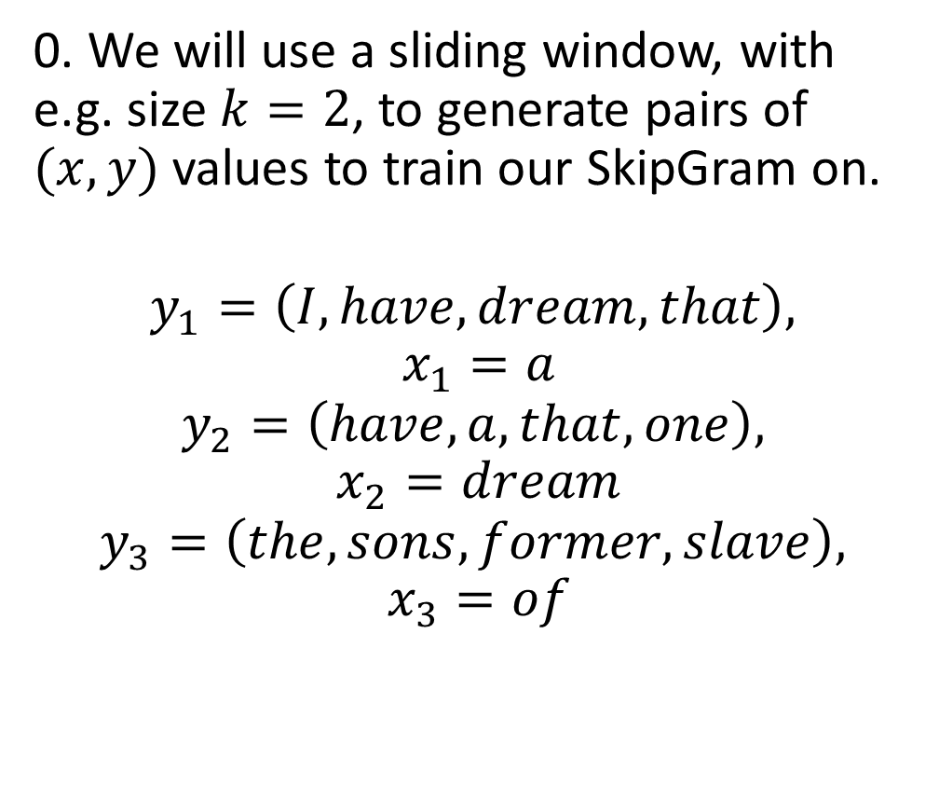
SkipGram (SG)
Consider the text: “I have a dream that one day this nation will rise up and live out the true meaning of its creed: We hold these truths to be self-evident, that all men are created equal. I have a dream that one day on the red hills of Georgia, the sons of former slaves and the sons of former slave owners will be able to sit down together at the table of brotherhood.”
0. We will use a sliding window, with e.g. size $k=2$, to generate pairs of $(x, y)$ values to train our SkipGram on.
$$y_{1}=\left(I, have,dream, that\right),$$
$$x_{1}=a$$
$$y_{2}=\left(have,a, that,one\right),$$
$$x_{2}=dream$$
$$y_{3}=\left(the, sons, former, slave\right),$$
$$x_{3}=of$$

Slide 8
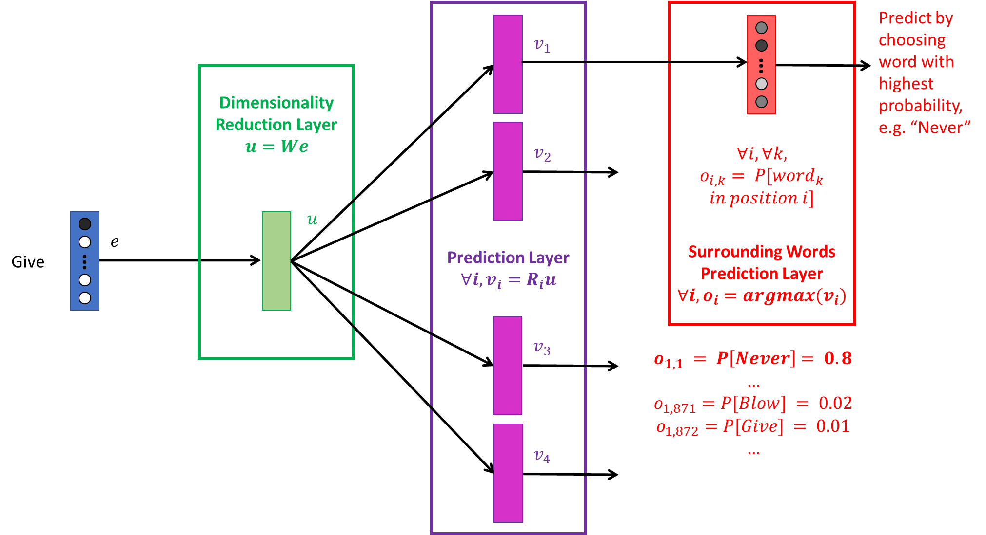
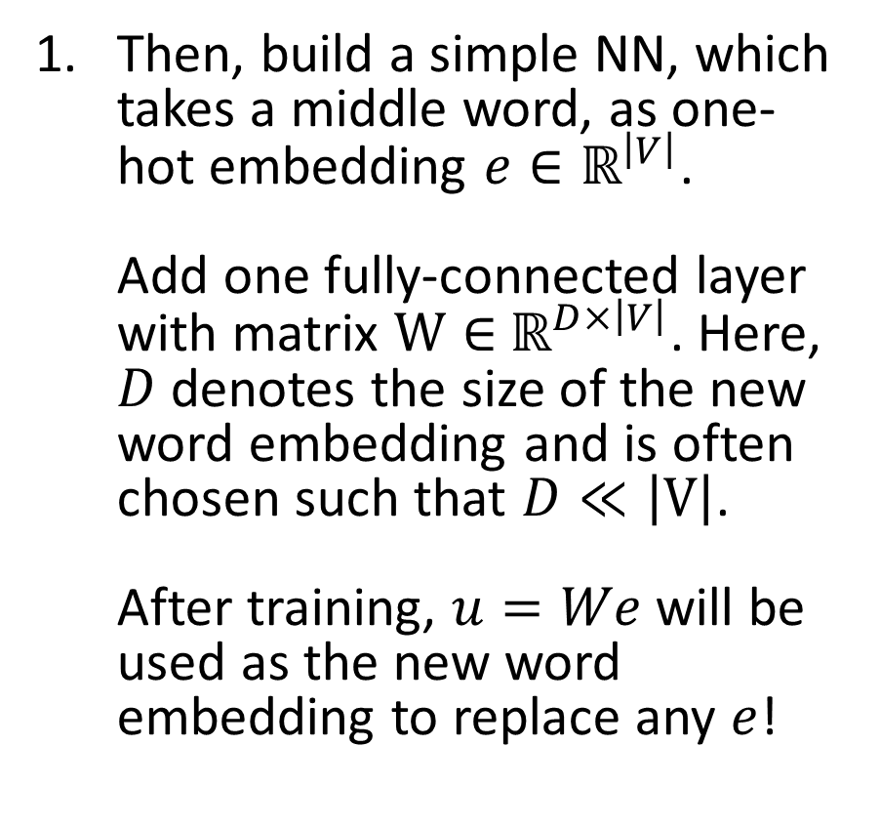
SkipGram (SG)
Then, build a simple NN, which takes a middle word, as one-hot embedding $e∈ℝ^{\left|V\right|}$. Add one fully-connected layer with matrix $W∈$ $ℝ^{D×\left|V\right|}$. Here, $D$ denotes the size of the new word embedding and is often chosen such that $D≪\left|V\right|$. After training, $u=We$will be used as the new word embedding to replace any $e$!

Slide 9
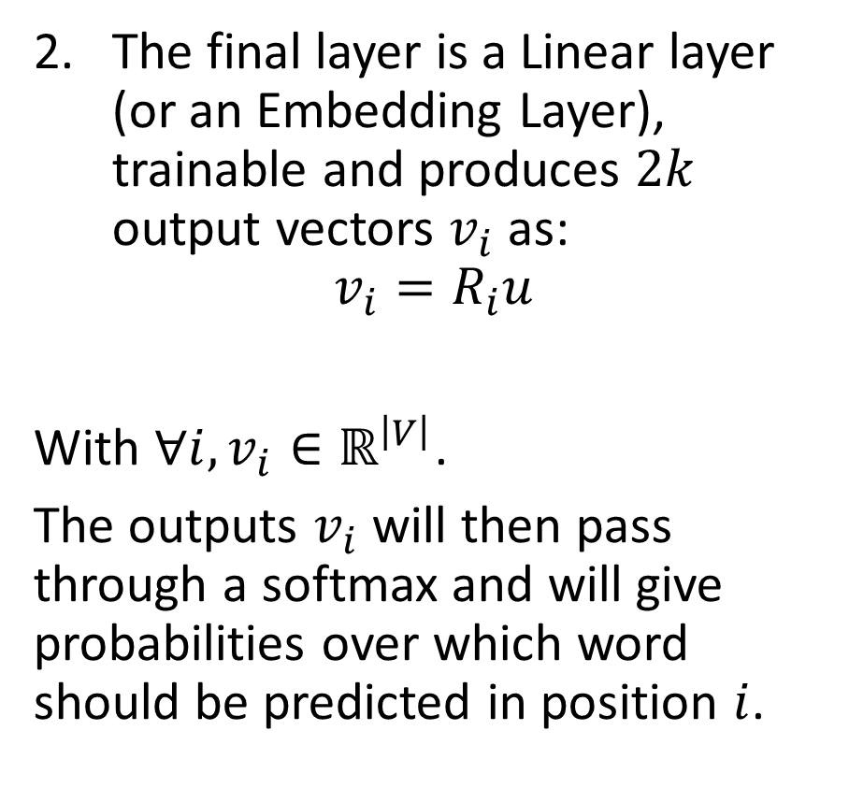
SkipGram (SG)
The final layer is a Linear layer (or an Embedding Layer), trainable and produces $2k$ output vectors $v_{i}$ as:
$$v_{i}=R_{i}u$$
With $∀i, v_{i}∈ℝ^{\left|V\right|}$.
The outputs $v_{i}$will then pass through a softmax and will give probabilities over which word should be predicted in position $i$.

Slide 10
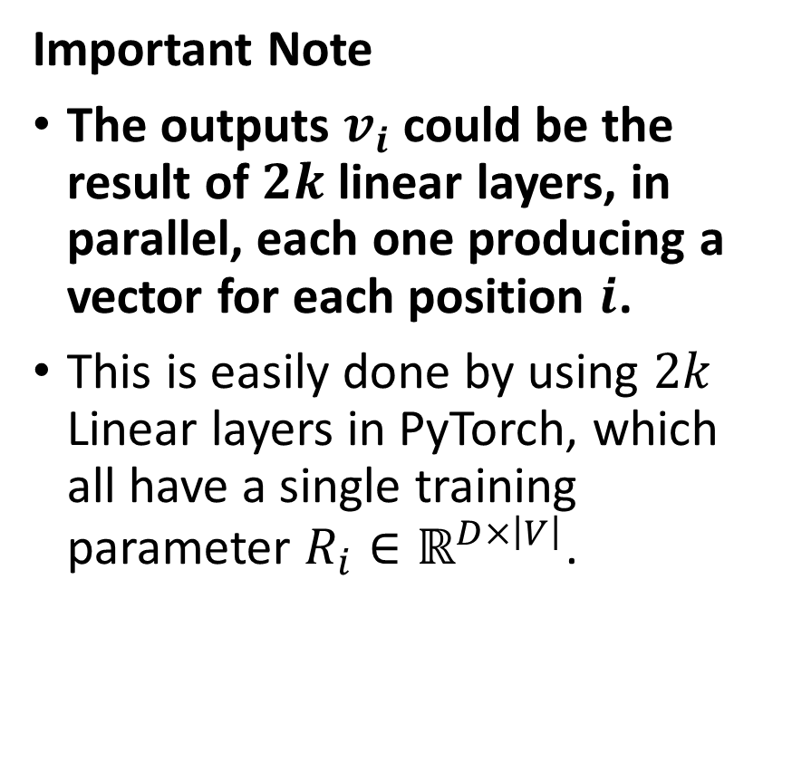
SkipGram (SG)
Important Note
The outputs $v_{i}$could be the result of $2k$ linear layers, in parallel, each one producing a vector for each position $i$.
This is easily done by using $2k$ Linear layers in PyTorch, which all have a single training parameter $R_{i}∈ℝ^{D×\left|V\right|}$.

Slide 11
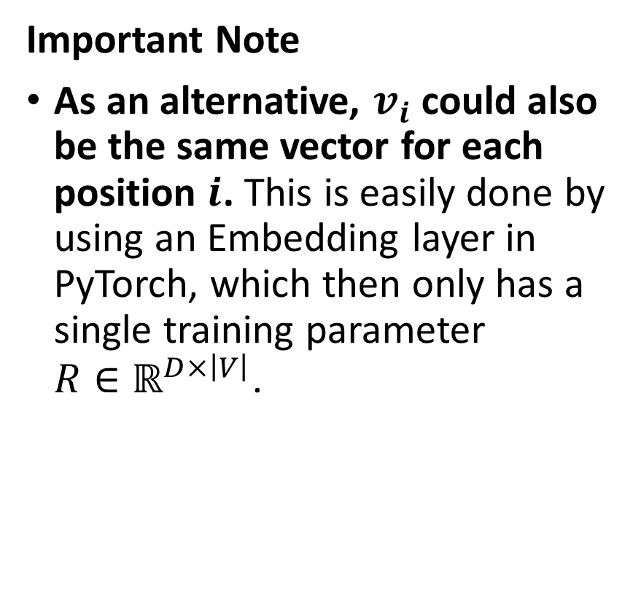
SkipGram (SG)
Important Note
As an alternative, $v_{i}$could also be the same vector for each position $i$. This is easily done by using an Embedding layer in PyTorch, which then only has a single training parameter $R∈ℝ^{D×\left|V\right|}$.

Slide 12
SkipGram (SG)
Important Notes:
Choosing the Linear layers or Embedding layer route has little to no importance here (as long as you correctly implement the loss function you need to use!).

Slide 13
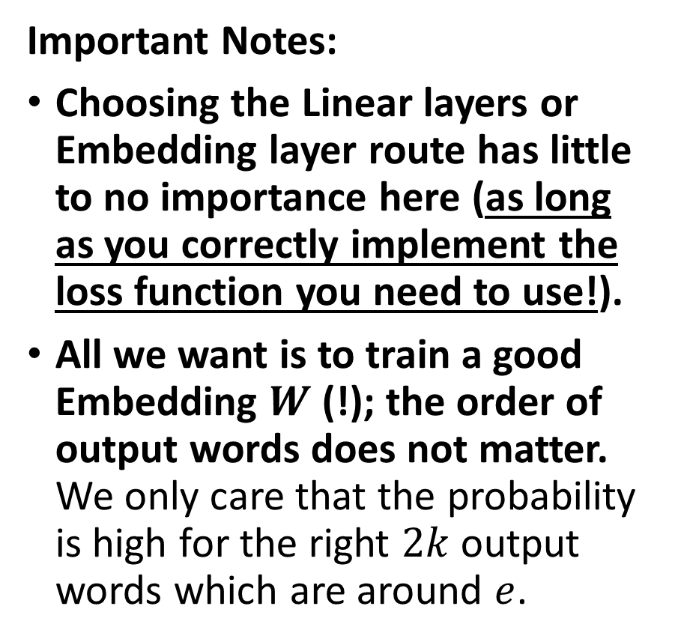
SkipGram (SG)
Important Notes:
Choosing the Linear layers or Embedding layer route has little to no importance here (as long as you correctly implement the loss function you need to use!).
All we want is to train a good Embedding $W$ (!); the order of output words does not matter. We only care that the probability is high for the right $2k$ output words which are around $e$.

Slide 14
SkipGram (SG)
Important Notes:
This also means that training a SkipGram is far more difficult than training a CBoW!
However, the intuition is that it will be producing better encodings, as it produces embedding that are able to describe any word by (somewhat) predicting the surrounding words around it.
Intuition: CBoW vs. SkipGram
Embedding task is more difficult,
NN needs to work harder to figure out a meaningful embedding,
Embedding from SKipGram will therefore be better?

Slide 15
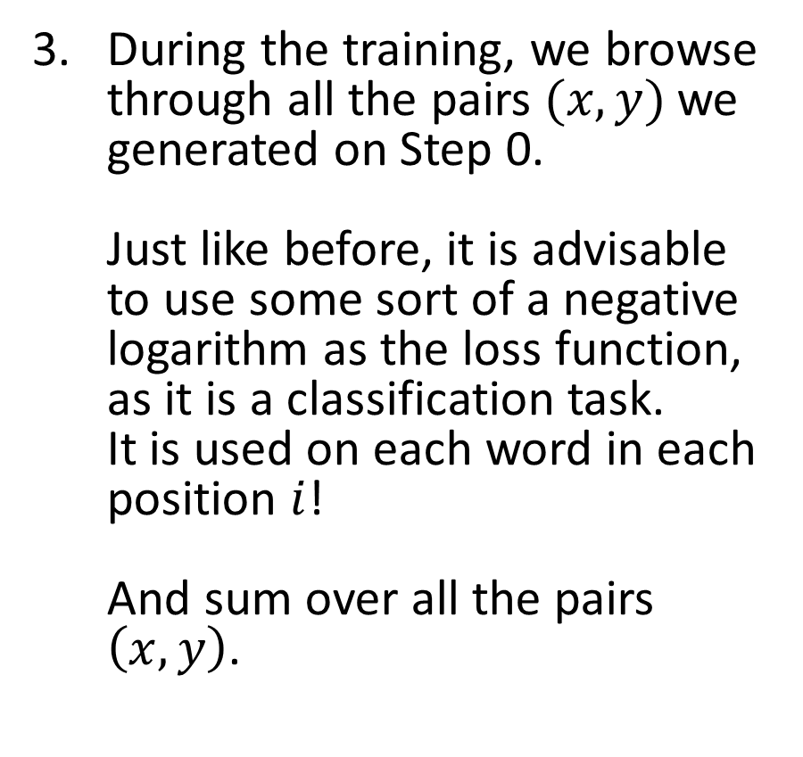
SkipGram (SG)
During the training, we browse through all the pairs $(x,y)$we generated on Step 0. Just like before, it is advisable to use some sort of a negative logarithm as the loss function, as it is a classification task. It is used on each word in each position $i$! And sum over all the pairs $\left(x,y\right)$.

Slide 16
Word2Vec and Glove
The two approaches (CBoW and SkipGram) are commonly referred to as Word2Vec approaches.
Another option, often referred to in literature is GloVe (Global Vectors for Word Representation). Another “simple” count-based embedding [GloVe2014] and was considered a good challenger to Word2Vec.
Choose a Pre-Trained Embedding If
Your dataset is composed of more “general” language and you don’t have that big of a dataset, to begin with.
Since these embeddings have been trained on a lot of words from different sources, pre-trained models might do well if your data is generalized as well.
Also, you will save on time and computing resources with pre-trained embeddings.

Slide 17
Word2Vec and Glove
Choose to Train Your Own Embedding If
Your data (and project) is based on a niche industry, such as medicine, finance or any other non-generic and highly specific domains.
In such cases, a general word embedding representation might not work out for you and some words might be altogether missing from the pre-trained embeddings.
Keep in mind, however,…
On the downside, a lot of data is needed to ensure that the word embeddings being learned do a proper job of representing the various words and the semantic relationships between them, unique to your domain.
Also, it takes a lot of computing resources to go through your corpus and build word embeddings.

Slide 18
Word2Vec and Glove
Both Word2Vec and GloVe approaches are commonly referred to as unsupervised (or semi-supervised) approaches to embedding, both relying on the distributional hypothesis we mentioned in the previous lecture.
Unsupervised representation learning of sentences had been the norm for quite some time.
More advanced versions of unsupervised approaches exist!
For instance: FastText and ELMo.

Slide 19
FastText
FastText was developed by the team of Mikolov (him again!), triggering the explosion of research on universal word embeddings [Mikolov2017, Bojanovski2017].

Slide 20
Universal embeddings?
Definition (Universal Embedding):
A huge trend in DL/NLP is the quest for Universal Embeddings.
Universal Embeddings are embeddings that are pre-trained on a large corpus and can be plugged in a variety of downstream task models to automatically improve their performance, by incorporating some general word/sentence representations learned on larger datasets.
In a sense, it is the ultimate form of transfer learning for language embeddings, the holy grail, i.e. a unique universal embedding that everyone can use on any task related to language.
Open question: Are universal embeddings even possible or good? Should not they be task-specific?

Slide 21
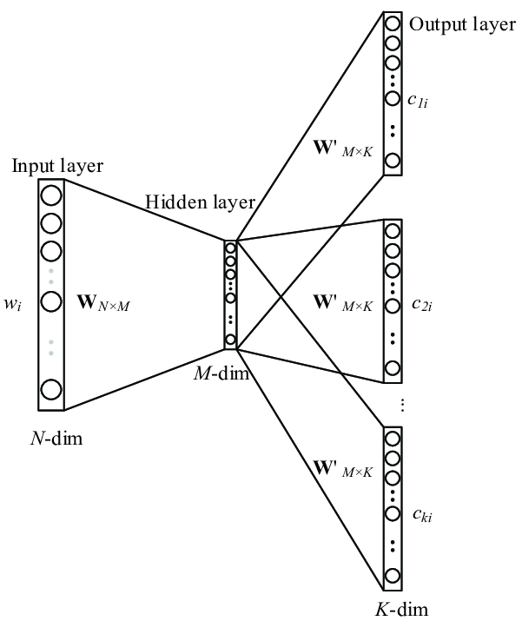
FastText
Input: Concatenation of word + its n-grams.
(e.g. “eating” + “ea” + “eat” + “ati” + “tin” + “ing”)
FastText was developed by the team of Mikolov (him again!), triggering the explosion of research on universal word embeddings [Mikolov2017, Bojanovski2017].
Inclusion of character n-grams, which allows computing word representations for words that did not appear in the training data (something called “out-of-vocabulary” words).
Model: Skip-Gram Architecture
(Predict context words based on single word + its n-grams)
Output: 2k words of context.

Slide 22
“Out of vocabulary” words
Definition (out-of-vocabulary):
Embeddings are often subject to the out-of-vocabulary issue.
This is a simple concept: what should the embedding function be doing if it is asked to encode a word that is not contained in the original dictionary V?
(Think new words, typos, etc.)
Word $w∉V$
Word 𝑤∉𝑉
Embedding function $f(w)$
Embedding function 𝑓(𝑤)
???

Slide 23
“Out of vocabulary” words
Definition (out-of-vocabulary):
Embeddings are often subject to the out-of-vocabulary issue.
This is a simple concept: what should the embedding function be doing if it is asked to encode a word that is not contained in the original dictionary V?
(Think new words, typos, etc.)
In the case of Word2Vec (CBoW and SkipGram algorithms), this would be very invalidating, as we would have no way to one-hot encode the missing word.
A good embedding function should then be able to, at least partially, operate on out-of-vocabulary words.
Word $w∉V$
Word 𝑤∉𝑉
Embedding function $f(w)$
Embedding function 𝑓(𝑤)
???

Slide 24
Core idea behind FastText (out-of-class)
Input: Concatenation of word + its n-grams.
(e.g. “eating” + “ea” + “eat” + “ati” + “tin” + “ing”)
FastText achieves really good performance for word representations, especially in the case of rare words by making use of character level information.
Each word is represented as a bag of characters n-grams in addition to the word itself.
For example, for the word “computer”, with n = 3, the FastText representations for the character n-grams is <co, com, omp, mpu, put, ute, ter, er>.
Model: Skip-Gram Architecture
(Predict context words based on single word + its n-grams)
Output: 2k words of context.

Slide 25
Core idea behind FastText (out-of-class)
Input: Concatenation of word + its n-grams.
(e.g. “eating” + “ea” + “eat” + “ati” + “tin” + “ing”)
Then, FastText uses the same approach and logic as in SkipGram, to try and predict some context words, by using the word and its n-grams.
This typically allows to identify etymology in words, and cover for potential typos!
Overall reinforces the performance, allows to address the out of vocabulary issue!
Model: Skip-Gram Architecture
(Predict context words based on single word + its n-grams)
Output: 2k words of context.

Slide 26
FastText - Recap
FastText was developed by the team of Mikolov (him again!), triggering the explosion of research on universal word embeddings [Mikolov2017, Bojanovski2017].
Inclusion of character n-grams, which allows computing word representations for words that did not appear in the training data (something called “out-of-vocabulary” words).
FastText vectors are super-fast to train and are available in 157 languages. They are a great baseline, not sacrificing too much performance.
Ready-to-use FastText embeddings from: https://github.com/facebookresearch/fastText
Official (and good) tutorial: https://fasttext.cc/docs/en/unsupervised-tutorial.html

Slide 27
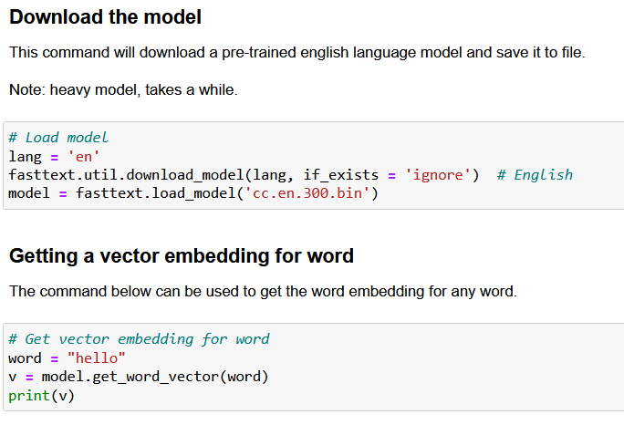
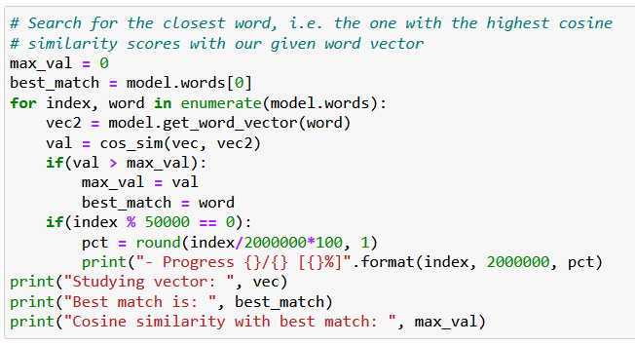
FastText - Demo
Have a look at Notebook 2, to see how we may download and reuse a pre-trained language model in Python, to produce or decode word embeddings.

Slide 28

ELMo
The Deep Contextualized Word Representations (a.k.a. Embeddings for Language Model - ELMo) have improved the state of the art in word embeddings by a noticeable amount.
They were developed by the Allen institute for AI and were presented at NAACL 2018 in early June [Peters2018].
Ready-to-use ELMo embeddings https://allennlp.org/elmo
Official and good tutorial: https://guide.allennlp.org/

Slide 29
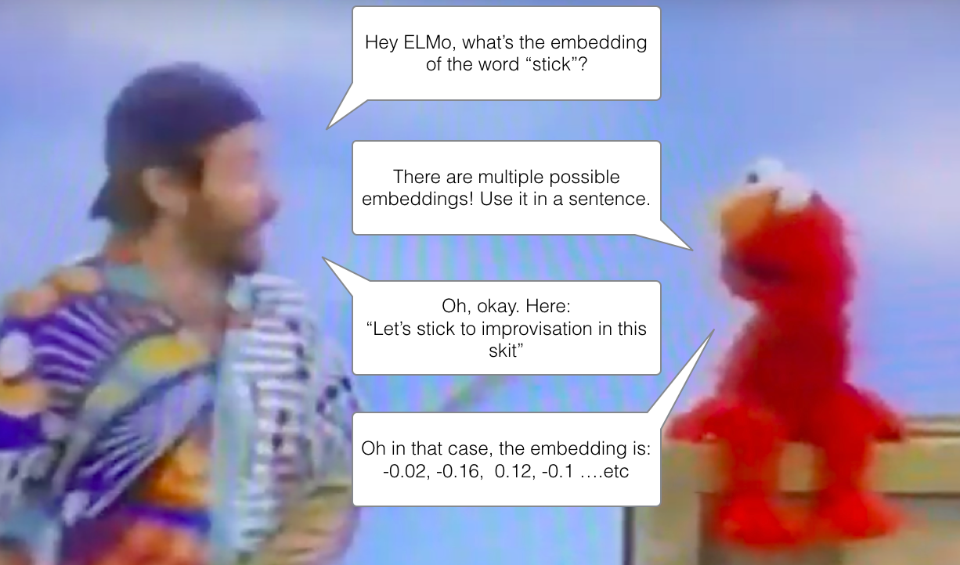
ELMo can take context into account
So far, all the language models we have seen produced embeddings for words…
But the embeddings would not change based on context (surrounding words in sentence).
This means that homonyms will have identical embeddings, despite having very different meanings.

Slide 30
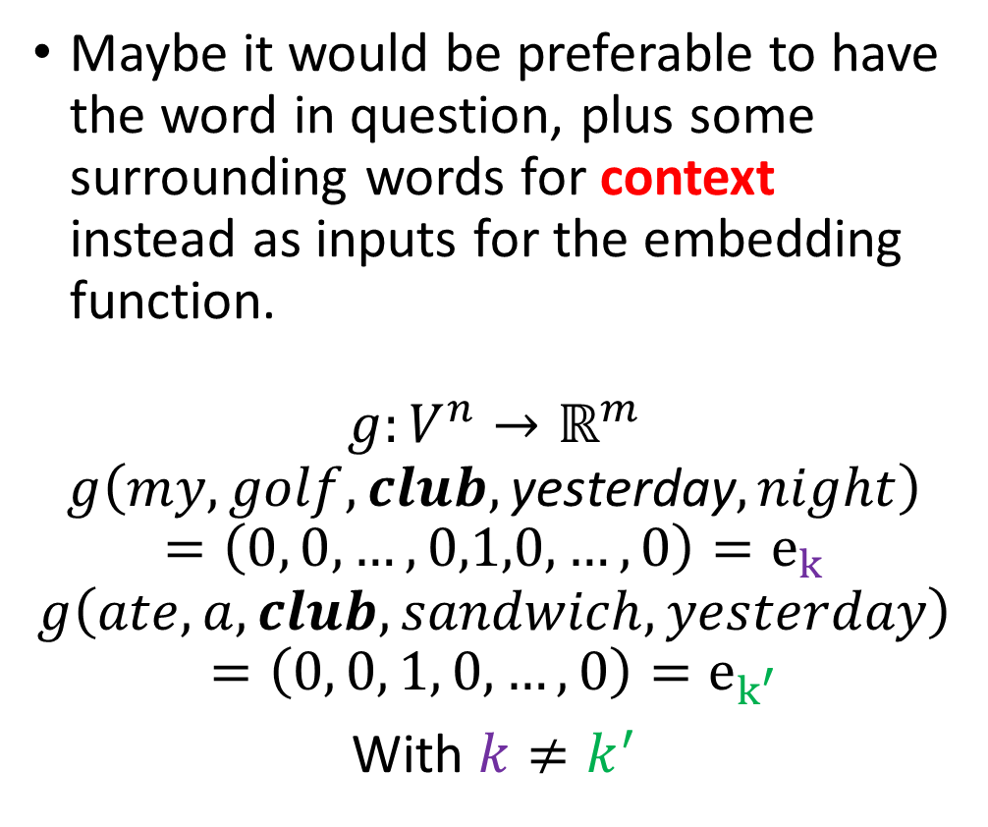
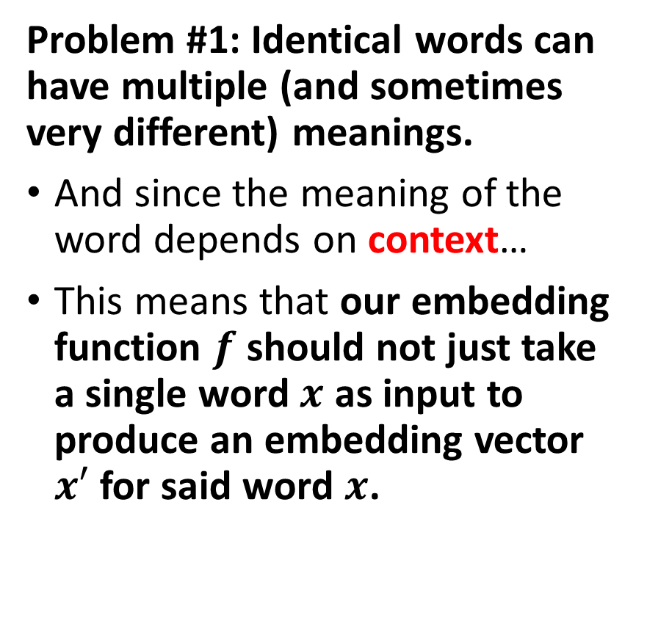
ELMo can take context into account - A blast from the past (W9S1)
Problem #1: Identical words can have multiple (and sometimes very different) meanings.
And since the meaning of the word depends on context…
This means that our embedding function $f$ should not just take a single word $x$ as input to produce an embedding vector $x′$ for said word $x$.
Maybe it would be preferable to have the word in question, plus some surrounding words for context instead as inputs for the embedding function.
$$g:V^{n}→ℝ^{m}$$
$$g\left(my, golf, club,\text{yesterday}, night\right)$$
$$=\left(0, 0, …,0,1,0,…,0\right)=e_{k}$$
$$g\left(ate, a, club,sandwich, yesterday\right)$$
$$=\left(0, 0, 1, 0,…,0\right)=e_{k^{′}}$$
With $k≠k^{′}$
I ate a club sandwich yesterday.
I broke my golf club yesterday night.

Slide 31
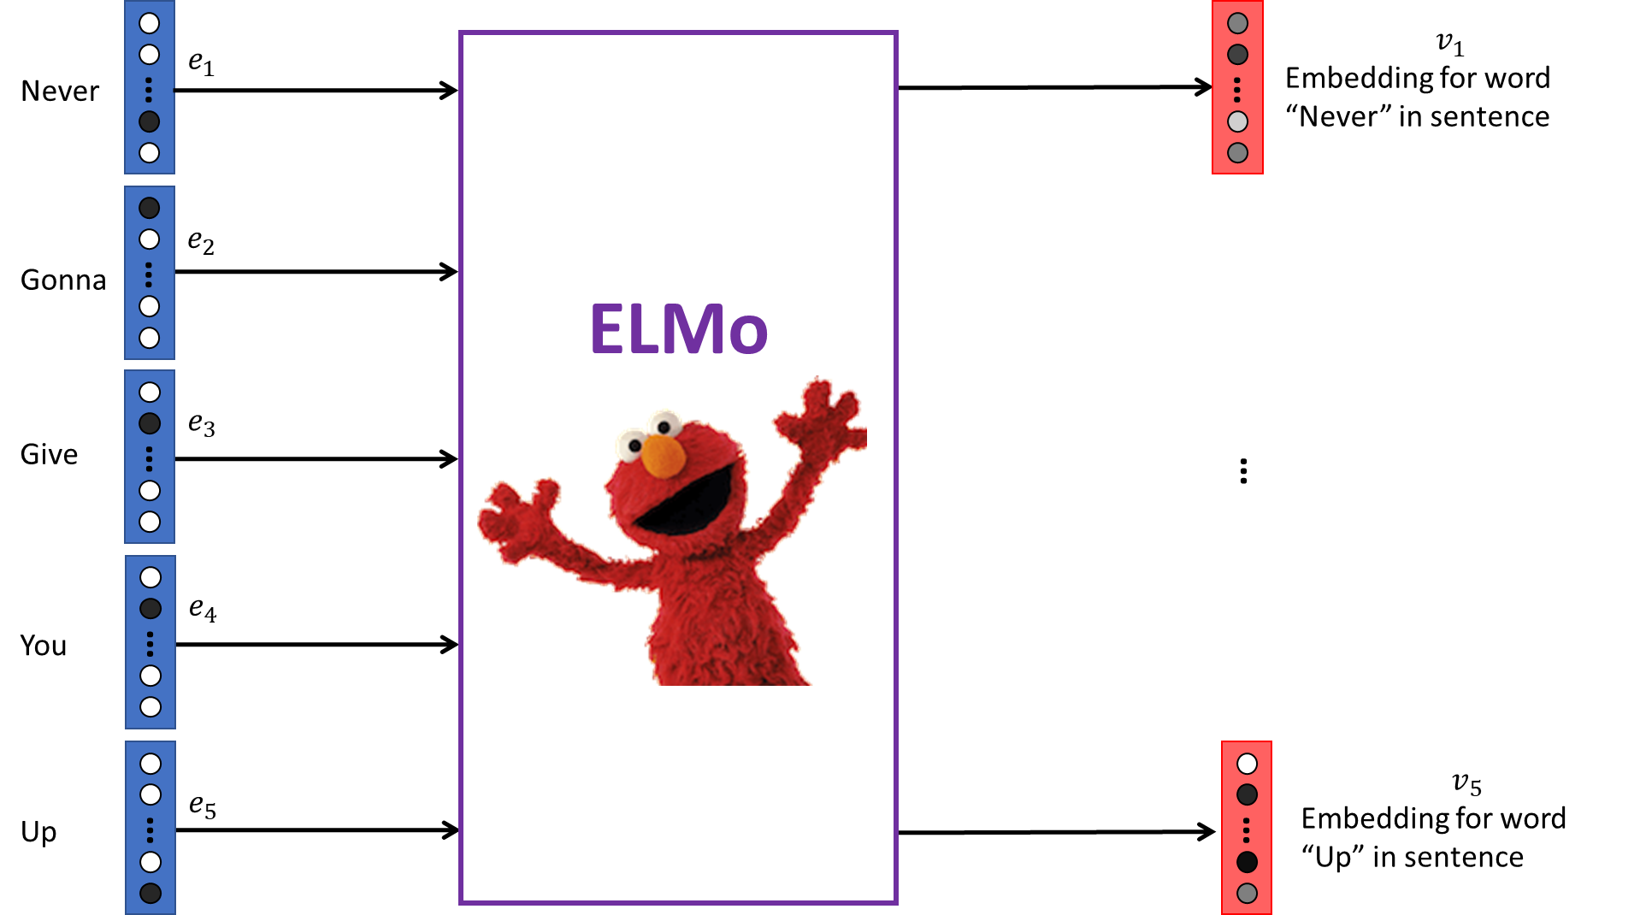
ELMo – Key takeaways
ELMo expects inputs of entire sentences and will then produce embeddings for all words in the sentence separately. To get an embedding of a word, input the whole sentence for context, then extract only the embedding vector which corresponds to that word.

Slide 32
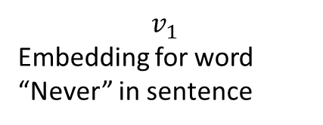





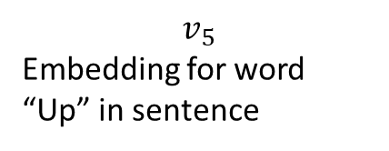
$$v_{1}$$
Embedding for word “Never” in sentence
$$e_{1}$$
ELMo
Never
…
…
$$e_{2}$$
Gonna
…
$$e_{3}$$
Give
…
…
$$e_{4}$$
You
…
$$v_{5}$$
Embedding for word “Up” in sentence
…
$$e_{5}$$
…
Up

Slide 33
ELMo – Key takeaways
ELMo does not take in words inputs as one-hot vectors, instead, it will decompose them into characters.

Slide 34
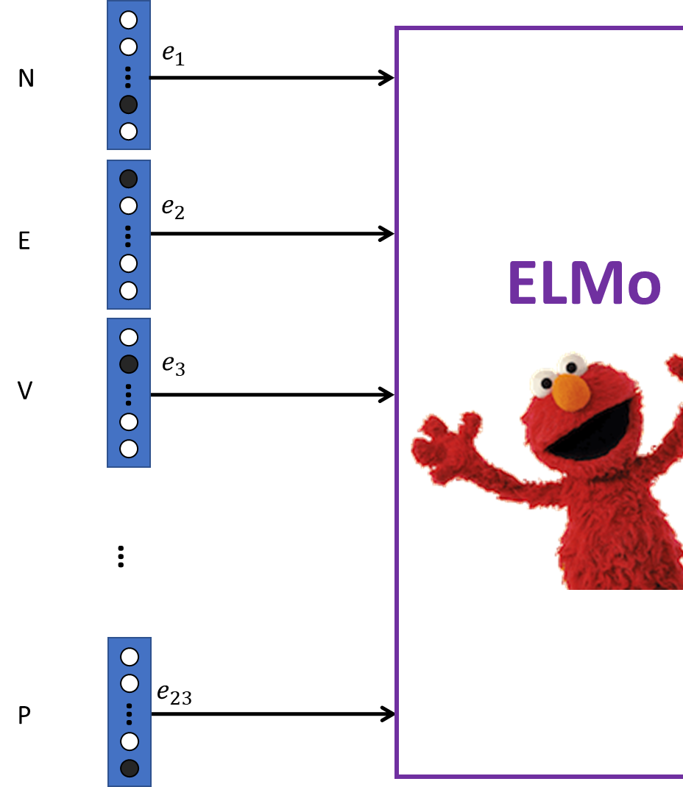
ELMo – Key takeaways
ELMo does not take in words inputs as one-hot vectors, instead, it will decompose them into characters. The characters will then be represented as one-hot vectors and fed as inputs. (Which is nice, lower dimensionality on possible characters compared to possible words!)

Slide 35
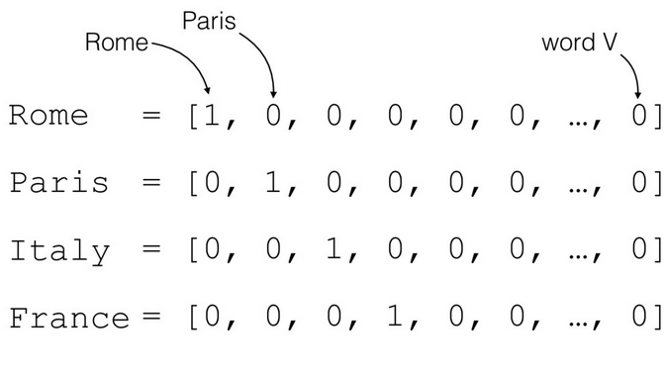
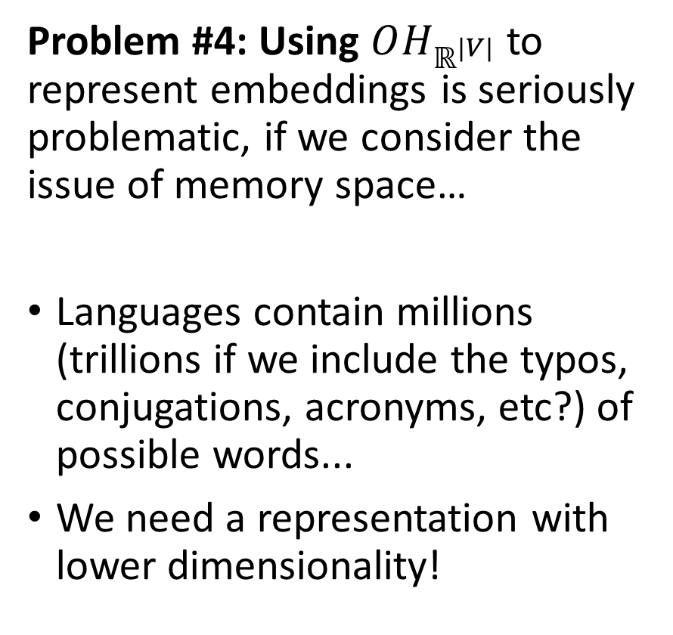
Remember problem #4?
Problem #4: Using $OH_{ℝ^{|V|}}$ to represent embeddings is seriously problematic, if we consider the issue of memory space…
Languages contain millions (trillions if we include the typos, conjugations, acronyms, etc?) of possible words...
We need a representation with lower dimensionality!
What is the size of this vector?!
How many zeros in there?!
→ Characters, on the other end, can be represented as one-hot vectors, with much lower dimensionality!

Slide 36
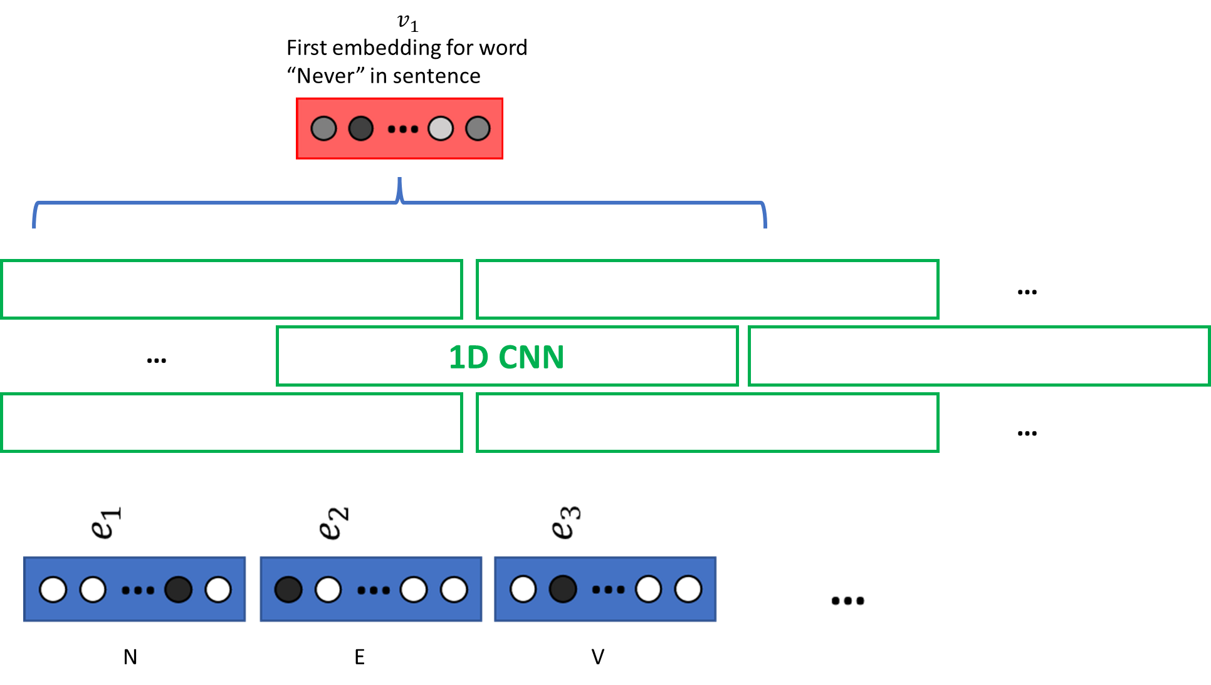
ELMo – Key takeaways
The bottom layer of ELMo will combine and process characters together. It consists of a succession of several (1D) CNN layers. Intuition: combining neighbouring characters allows to extract meaning through etymology! Also, it solves the out-of-dictionary problem!

Slide 37

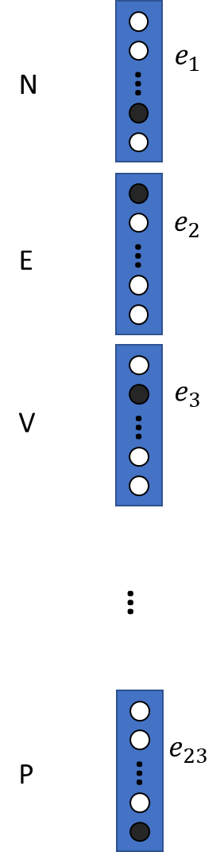
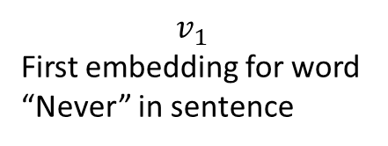
$$v_{1}$$
First embedding for word “Never” in sentence
…
…
1D CNN
…
N
E
V

Slide 38
ELMo – Key takeaways
Technicalities for 1D CNNs
Character-level vectors go through 1D convolutional layers with different kernel sizes.
The original “small” ELMo model used kernels of size 1, 2, 3, 4, 5, 6, 7 with 32, 32, 64, 128, 256, 512, 1024 channels, respectively.
Outputs from each convolutional layers are then max-pooled and concatenated.
The final concatenated vector, of size 2048, can be used as a first word embedding. But it does not benefit from context yet.
Remember the convolution layers lectures: convolutional layers are well known for their feature-extracting properties… This first operation can therefore be regarded as a character-level context extraction process!

Slide 39
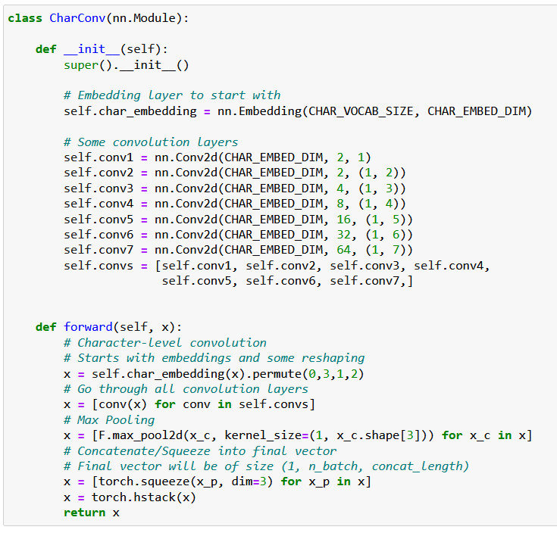
ELMo – Key takeaways
From Notebook 3
In our implementation, kernel sizes are slightly different, and lead to a 128-length vector in the end.
Interleaving with Max-Pool as suggested in the “original” ELMo model.
Adding an embedding layer at the beginning.

Slide 40






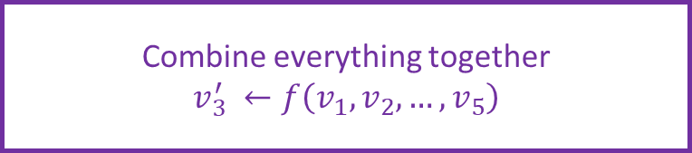
ELMo – Key takeaways
The top layer of ELMo will combine and transfer context from words to each other. What we want:
A process or function that will transform the first word embedding we produced from the character-level CNN,
Into a new word vector, which has transferred context from words with each other.
$$v_{1}$$
$$v_{2}$$
$$v_{3}$$
$$v_{4}$$
$$v_{5}$$
Who’s eating?
What is being eaten?
Original Representation of word “eats”
Combine everything together
$$v_{3}^{′} ←f\left(v_{1}, v_{2}, …, v_{5}\right)$$
$${v′}_{3}$$

Slide 41
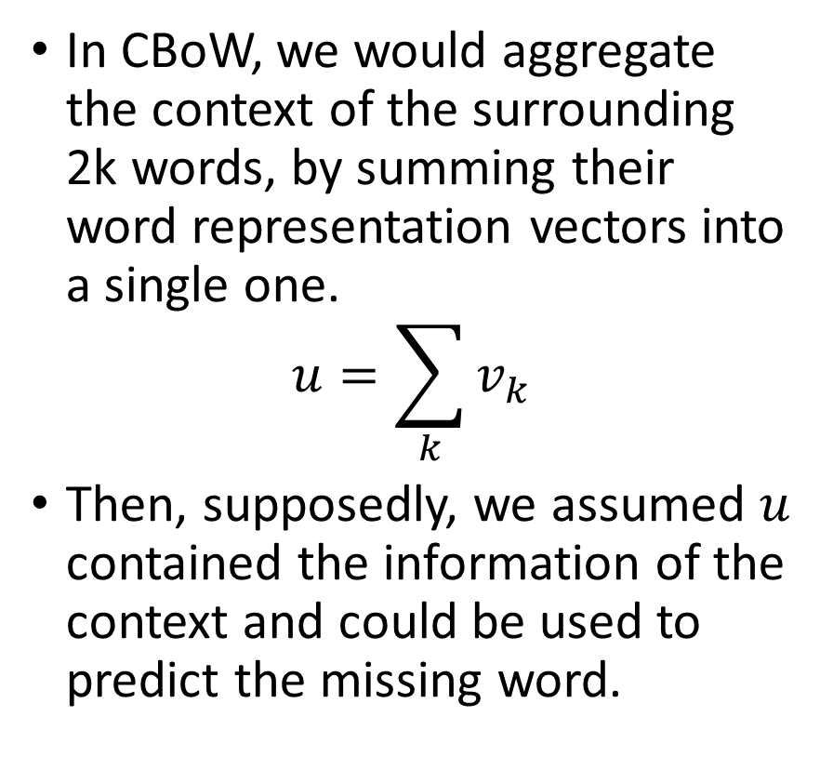
Context Aggregation in CBoW (Reminder)
In CBoW, we would aggregate the context of the surrounding 2k words, by summing their word representation vectors into a single one.
$$u=\sum_{k}{v_{k}}$$
Then, supposedly, we assumed $u$ contained the information of the context and could be used to predict the missing word.
→ Can we do better?

Slide 42
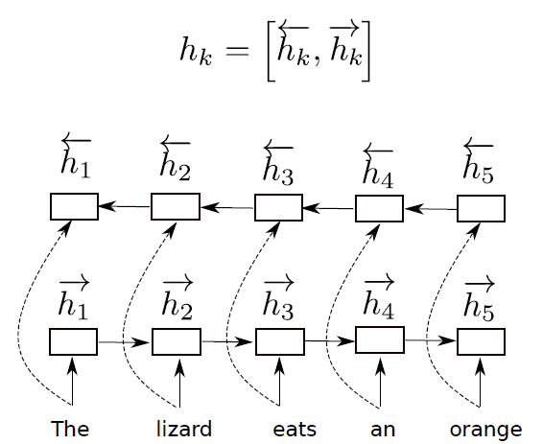
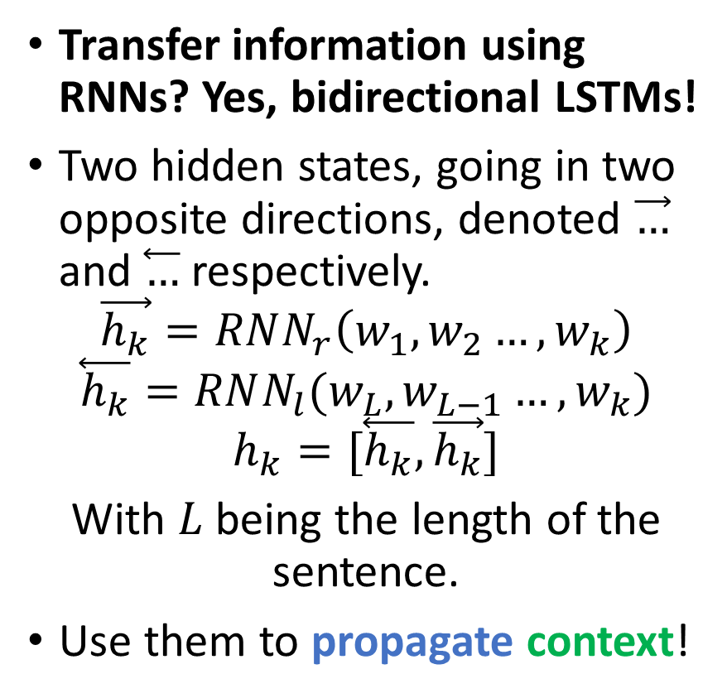
Context aggregation using Bi-LSTMs
Transfer information using RNNs? Yes, bidirectional LSTMs!
Two hidden states, going in two opposite directions, denoted $\vec{…}$ and $\overset{⃖}{…}$ respectively.
$$\vec{h_{k}}=RNN_{r}\left(w_{1},w_{2}…,w_{k}\right)$$
$$\overset{⃖}{h_{k}}=RNN_{l}(w_{L},w_{L−1}…,w_{k})$$
$$h_{k}=[\overset{⃖}{h_{k}},\vec{h_{k}}]$$
With $L$ being the length of the sentence.
Use them to propagate context!
→ Supposedly better (more sophisticated and trainable), but heavier.

Slide 43
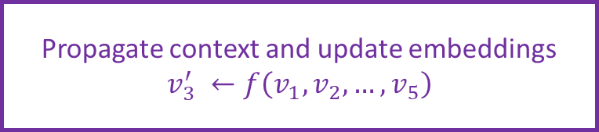
ELMo – Key takeaways
The top layer of ELMo will combine and transfer context from words to each other What we want:
A process or function that will transform the first word embedding we produced from the character-level CNN,
Into a new word vector, which has transferred context from words with each other.
→ Use a bi-directional LSTM!
$$v_{1}$$
$$v_{2}$$
$$v_{3}$$
$$v_{4}$$
$$v_{5}$$
Who’s eating?
What is being eaten?
Original Representation of word “eats”
Propagate context and update embeddings
$$v_{3}^{′} ←f\left(v_{1}, v_{2}, …, v_{5}\right)$$
$${v′}_{3}$$

Slide 44
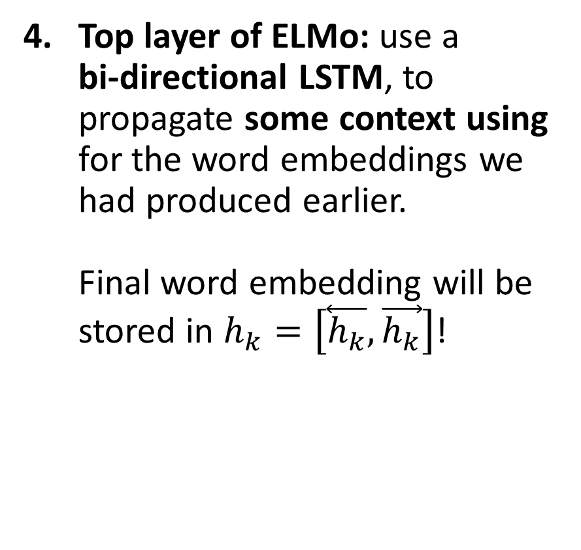
ELMo – Key takeaways
Top layer of ELMo: use a bi-directional LSTM, to propagate some context using for the word embeddings we had produced earlier. Final word embedding will be stored in $h_{k}=\left[\overset{⃖}{h_{k}},\vec{h_{k}}\right]$!
$$v_{1}$$
$$v_{2}$$
$$v_{3}$$
$$v_{4}$$
$$v_{5}$$
Who’s eating?
What is being eaten?
Original Representation of word “eats”
Propagate context and update embeddings
$$v_{3}^{′} ←f\left(v_{1}, v_{2}, …, v_{5}\right)$$
$${v′}_{3}$$

Slide 45
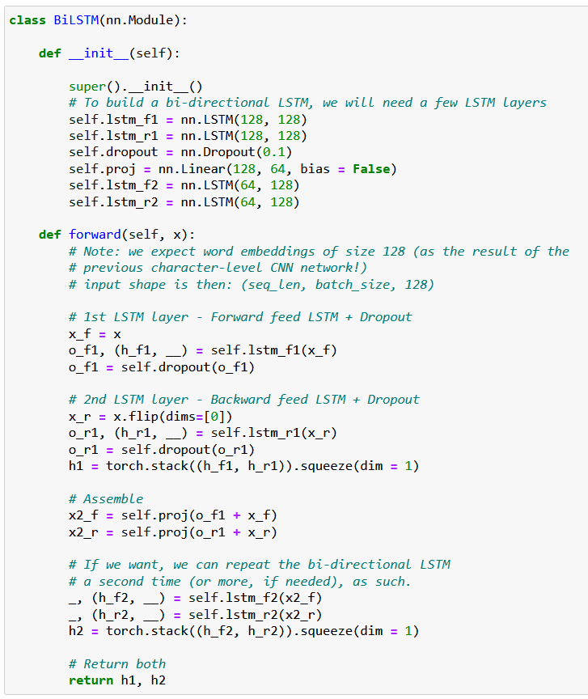
ELMo – Key takeaways
Top layer of ELMo: use a bi-directional LSTM, to propagate some context using for the word embeddings we had produced earlier. Final word embedding will be stored in $h_{k}=\left[\overset{⃖}{h_{k}},\vec{h_{k}}\right]$!

Slide 46
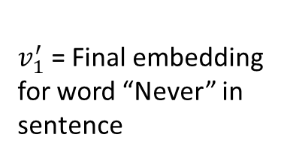
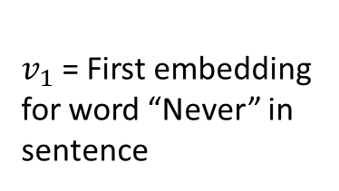
ELMo – Key takeaways
$v_{1}^{′}$= Final embedding for word “Never” in sentence
Context Propagation with Bi-LSTM
So far, we could connect both models and they technically would work just fine…
$v_{1}$= First embedding for word “Never” in sentence
Character-level CNNs
N
E
V

Slide 47
ELMo – Key takeaways
$v_{1}^{′}$= Final embedding for word “Never” in sentence
Context Propagation with Bi-LSTM
So far, we could connect both models and they technically would work just fine… In practice, however, we like to add a few extra Linear layers in the middle to allow for a smoother transition.
Some FeedForward using Highway Layers
$v_{1}$= First embedding for word “Never” in sentence
Character-level CNNs
N
E
V

Slide 48
ELMo – Key takeaways
$v_{1}^{′}$= Final embedding for word “Never” in sentence
Context Propagation with Bi-LSTM
In the middle: Add some Feedforward layers This allows for a smoother transition from the character-level CNNs output to the Bi-LSTM input. Can be simply done with a succession of Linear layers. Or a variation of Linear layers, called a highway network.
Some FeedForward using Highway Layers
$v_{1}$= First embedding for word “Never” in sentence
Character-level CNNs
N
E
V

Slide 49
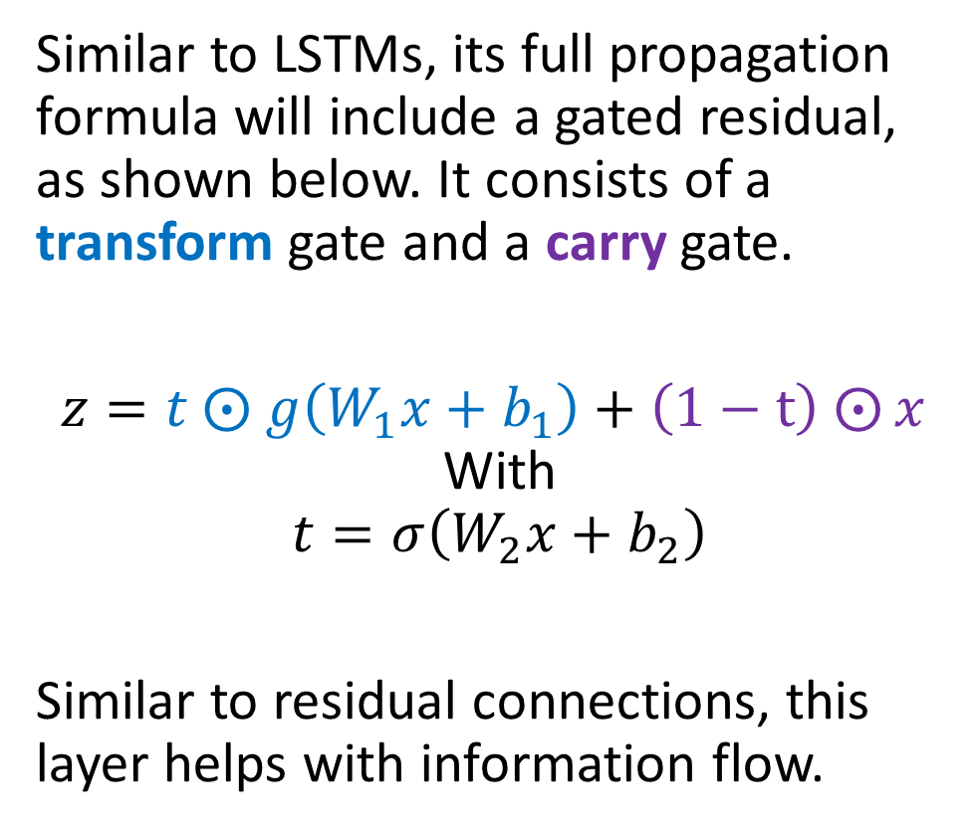
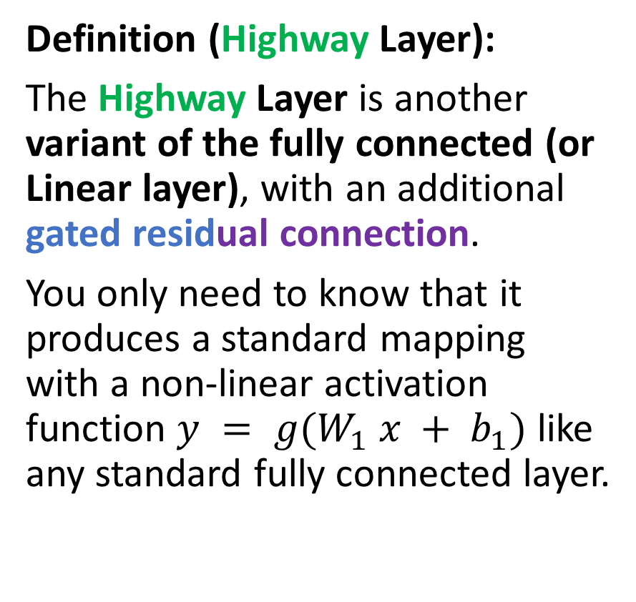
A note on the Highway Layer
Definition (Highway Layer):
The Highway Layer is another variant of the fully connected (or Linear layer), with an additional gated residual connection.
You only need to know that it produces a standard mapping with a non-linear activation function $y = g(W_{1} x + b_{1})$ like any standard fully connected layer.
Similar to LSTMs, its full propagation formula will include a gated residual, as shown below. It consists of a transform gate and a carry gate.
$z=t ⨀$ $g\left(W_{1}x+b_{1}\right)+\left(1−t\right)$ $⨀{x }$ With
$$t=σ\left(W_{2}x+b_{2}\right)$$
Similar to residual connections, this layer helps with information flow.

Slide 50
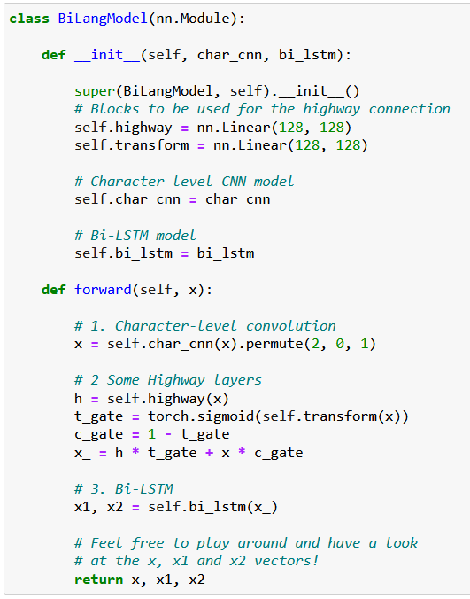
A note on the Highway Layer
Very similar to the gates we used in RNNs! (forget gate, input gate, etc.)

Slide 51
ELMo
On top of character-level network, use multiple layers of RNNs on word-level.
Some highway layers for transition in the middle.
Train the whole network for the task of predicting the next word in sentence, almost as in CBoW.
After training, extract embedding layer for feature representation
Final Recap
Input of words, into a character-level network (inputs will be a list of characters!)
To get an embedding of a word, input the whole sentence for context, then take only the vector which corresponds to that word.

Slide 52
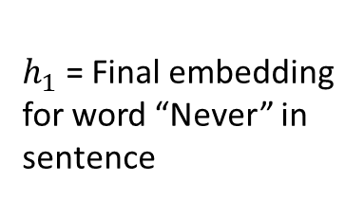
$h_{1}$= Final embedding for word “Never” in sentence
Context Propagation with Bi-LSTM
Some FeedForward using Highway Layers
$v_{1}$= First embedding for word “Never” in sentence
Character-level CNNs
N
E
V

Slide 53
ELMo
Key takeaways on ELMo
ELMO is able to operate on out-of-vocabulary words, as it takes characters as inputs, and can process context to address Problem #1 (as opposed to CBoW/SG & FastText)
Its main downside is the computational cost of the architecture. Preferable to use FastText if you need speed!
ELMo is a pretty recent word embedding (2018!), which has, for a long time, held the state-of-the-art performance for word embeddings.
These days (2021-2022), the state of the art are the (BERT and) GPT embeddings. To be discussed on the next lecture, after the lesson on transformers!

Slide 54
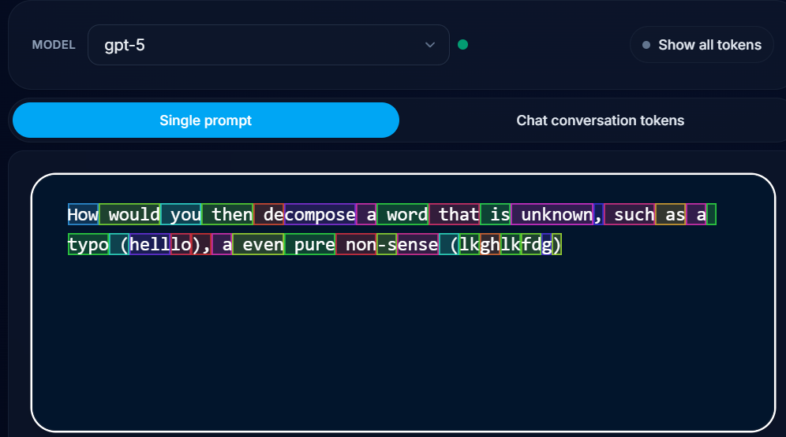
From characters to tokens?
Unhappiness
Un
Happi
Ness
Definition (tokens):
Eventually, the NLP community realised that using letters or n-grams as the most basic building block for text was a mistake.
Instead of splitting text into full words, n-grams, or single characters, GPT typically breaks text into frequently occurring substrings, which are called tokens.
GPT would then fall back onto character or n-grams decomposition, when tokenization fails (e.g. for out-of-vocabulary problems), efficiently getting the best of both worlds.
Try the GPT5 tokenizer here: https://gpt-tokenizer.dev/

Slide 55
Conclusion (W8S2)
We have seen a few approaches to embeddings.
Train an AI to figure out embeddings? Basic approaches.
(CBoW)
SkipGram
Out of dictionary entries?
Use FastText!
Need to incorporate context words for embedding?
Use ELMo!
A few more problems are still open at the moment for these word embeddings.
How de we evaluate embeddings and decide which one is best?
Can these embedding be biased? Yes, unfortunately.
Can we help the network in computing context? BERT, later.

Slide 56
Learn more about these topics
Out of class, for those of you who are curious
[Mikolov2013] Mikolov et al., “Efficient Estimation of Word Representations in Vector Space”, 2013. https://arxiv.org/abs/1301.3781
[Mikilov2014] Mikolov et al., “Distributed Representations of Words and Phrases and their Compositionality”, 2014. https://arxiv.org/abs/1310.4546
[GloVe2014] Pennington et al., “GloVe: Global Vectors for Word Representation”, 2014. https://nlp.stanford.edu/projects/glove/

Slide 57
Learn more about these topics
Out of class, for those of you who are curious
[Mikolov2017] Mikolov et al., “Advances in Pre-Training Distributed Word Representations”, 2017. https://arxiv.org/abs/1301.3781
[Bojanovski2017] Bojanowski et al., “Enriching Word Vectors with Subword Information”, 2017. https://arxiv.org/abs/1607.04606
[Peters2018] Peters et al., “Deep contextualized word representations”, 2018. https://arxiv.org/abs/1802.05365

Slide 58
Learn more about these topics
Tracking important names (Track their works and follow them on Scholar, Twitter, or whatever works for you!)
Matthew E. Peters: Research Scientist at Hugging Face. https://scholar.google.com/citations?user=K5nCPZwAAAAJ&hl=en
Hugging Face: Important company that develops and provides a range of natural language processing (NLP) tools for developers, researchers, and enterprises. Open-source libraries for NLP such as Transformers, Tokenizers, and Datasets. Hugging Face is well-known for its state-of-the-art models and tools for NLP, as well as its active open-source community. https://huggingface.co/

Slide 59

$$v_{1}$$
Embedding for word “Never” in sentence
$$e_{1}$$
ELMo
N
…
…
$$e_{2}$$
E
…
$$e_{3}$$
V
…
…
…
$$v_{5}$$
Embedding for word “Up” in sentence
…
$$e_{23}$$
…
P

Slide 60
$$v_{1}$$
First embedding for word “Never” in sentence
…
…
1D CNN
…
N
E
V
P

